Slide 1

Greenhouse Gas Emission Prediction
Katherine Williams 17kew2@queensu.ca
Molly Shillabeer 17mes10@queesu.ca

Slide 2
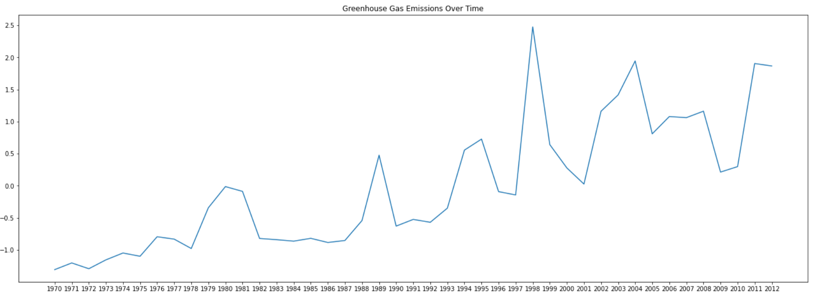
Introduction
Climate change has become a growing issue with devastating consequences. Emissions have been rising and we need to take action.

Slide 3


Problem Statement
GHG emissions rising
Current measurements do not give enough information
Measuring other global development indicators
Population, economic, electric, and healthcare related
Show more information about the GHG emission rates
Prediction
Patterns

Slide 4
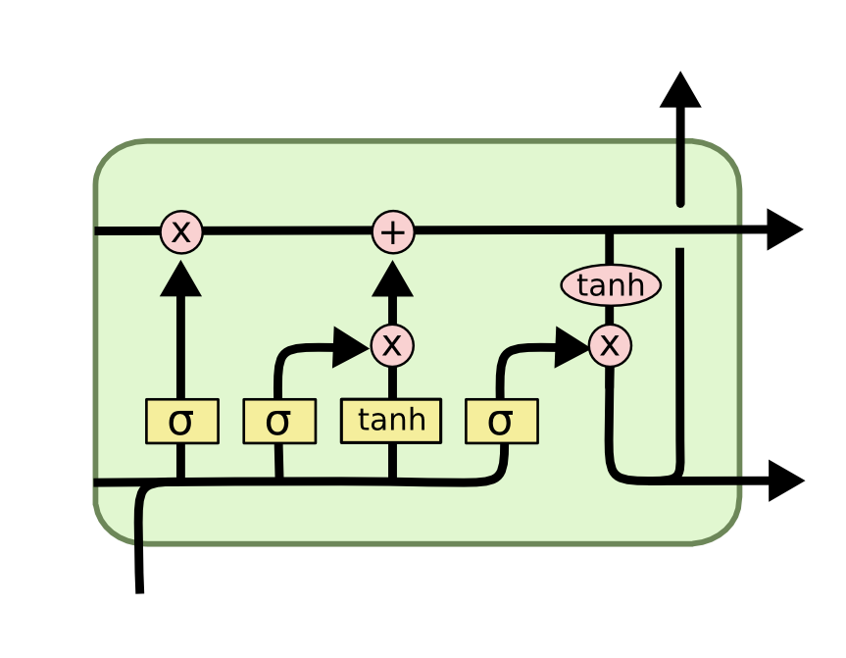
Method
World Bank open data → development indicators
LSTM Neural Network → accounts for time
Mean squared error
Problems:
Limited data
Units of measure

Slide 5
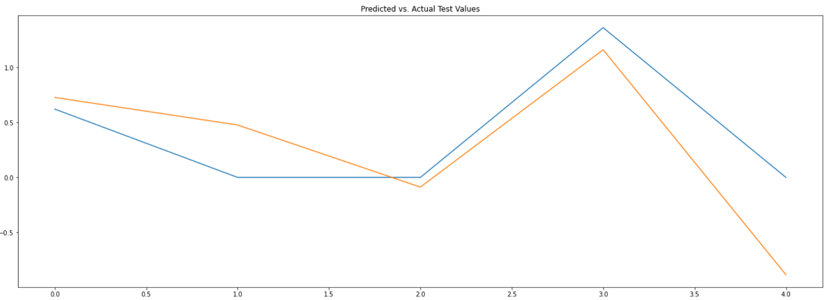
Results
R-squared score of 0.47

Slide 6
Conclusion
Results indicate the model was able to predict ~40% of the GHG emissions
Did not have up to date GHG emissions, 2012-1970
Sparse data
Although our results were not optimal
The idea of using other indicators to predict GHG emission is possible
Could allow countries to be more proactive and make more impactful change

Slide 7
THANK YOU
Notes:
Image 1: https://www.politico.com/news/magazine/2021/02/19/how-a-winter-storm-tested-texas-go-it-alone-attitude-470202
Image 2: https://colah.github.io/posts/2015-08-Understanding-LSTMs/

